Slide 1
POSITIVE MENTAL HEALTH AND RECOVERY MODEL
Joonas Korhonen. Senior lecturer, RN, PhD researcher, Come4Global-project

Slide 2
Introduction
POSITIVE MENTAL HEALTH
RECOVERY
“ Positive” as a character of the concept that makes it greater than freedom or absence of disorders or symptoms
Protective buffer for various life situations!
Resilience helps us to spring back from and cope in psychologically demanding situations
Social factors are strongly related to recovering mental health
Poor awareness and knowledge and strong attitudes towards mental health issues are widely globally recognized
Cultural context matters
Mental health literacy (MHL)
Recovery may not be a synonym for complete recovery ( i.e as recovering from the physical trauma)
Can been seen as “ realisation of goals, and the development of relationships and skills that support a positive life, with or without ongoing mental health problems” (Mental Health Foundation 2018

Slide 3
Health Literacy (HL) - strong predictor of prosperity
European study showed significant determinants for poor HL as low socio-economical status and lower education
“ worse health and thus higher demands for health services seems to be accompanied by lower levels of health literacy” (Sørensen et al. 2019)
i.e overeating, alcohol consumption, and smoking to as coping mechanisms (Delara 2015)
WHO states that HL predicts economic prosperity
Literate individuals participate and are more successful
Worse socioeconomic status may increase social limitation of immigrant women (Delara 2015)
Sørensen et al. 2019.Health literacy in Europe: comparative results of the European health literacy survey (HLS-EU)

Slide 4
Good mental health infrastructure in smart society
Lacking MHL among health care professionals increases the disease burden and inadequate treatment

Slide 5
RECOVERY MODEL
People with mental health disorders may move forward, set new goals, and take part in relationships and activities that are meaningful
Along with consept of positive psychology and social inclusion
Associated factors are:
Good relationships
Satisfying work
Personal growth
The right living environment

Slide 6
three conceptualizations of recovery-orientated practice (Le Boutillier et al.2015)
Clinical recovery
“a deficit perspective where mental state is improved or stabilised using medication and risk-management interventions”
measuring focuses on: symptom remission, insight gain, absence of relapse and mastery in daily living skills
Personal recovery
a holistic approach (incl. physical and psychological care)
Focuses on client-centred goals, service-user autonomy and decision-making
measured by citizenship involvement (including meaningful occupation and social inclusion).
Service-defined recovery
“the goals and financial needs of the organization”
Challenge: Public health providers still focused on symptom remission and client stabilization with lack of integration of recover model
Seen as a tool to reduce costs and measured by service throughput and service accessibility
Note that organisational priorities influence staff understanding of recovery support

Slide 7
the acronym “CHIME”
Recovery is a process
Connectedness, Hope and Optimism, Identity, Meaning and Purpose, and Empowerment = CHIME
https://youtu.be/Tedjw6nslrU

Slide 8
RECOVERY PROCESSES via CHIME _{(Leamey et al. 2011)}
RECOVERY
Connectedness
Peer and support groups
Hope and optimism about the future
Belief in possibility of recovery
Identity
Dimensions of Identity
Rebuilding positive sense of identity
Relationships
Support from others
Being part of the community
Motivation to change
Hope-inspiring relationships
Positive thinking and valueing success
Having dreams and aspirations
Overcoming stigma
Meaning in life
Meaning of mental health experiences
Spirituality
Quality of Life
Meaningful life, social roles and social goals
Rebuilding life
Empowerment
Personal responsibility
Control over life
Focusing upon strenghts

Slide 9
Limiting the significance of the disease
Veijo Nevalainen 2012 (modified)

Slide 10
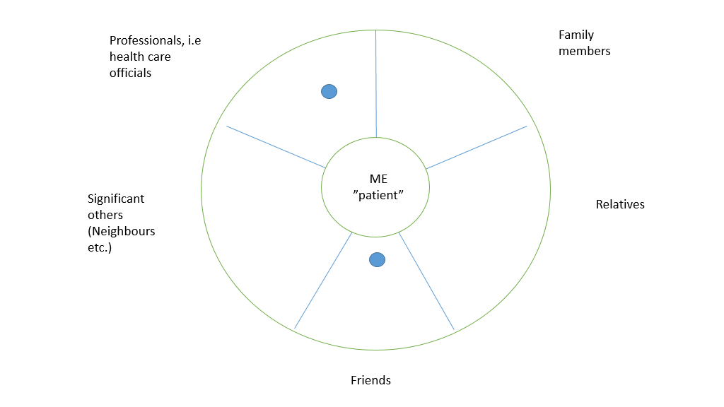

Slide 11
Supportive clinical questions for RECOVERY APRROACH _{(Nordling 2018)}
1. Did I help the customer identify and prioritize His/Her self set goals for recovery?
2. Did I express my trust in the client’s existing strengths in their pursuit of their goals?
3. Did I give “expert by experience” based examples that arouse and reinforce hope?
4. Did I point out that although the future is uncertain and setbacks can happen, is it possible to achieve the goals - did I give support to maintain hope and positive expectations?
5. Did I encourage the client to self-manage mental health problems by providing information and strengthening existing management strategies?
6. Did I listen client’s wishes of the therapeutic interventions and did I show him that I actually had listened?
7. Did I express my respectful attitude towards the customer and did I express my desire for an equal partnership when working together?
8. Did I point out that I am ready to “put myself on the stage” to help the customer achieve their goals?
9. Did I guide the client from their usual sick role to help others?
10. Did I consider crucial, non-direct mental health related essential resources, as friends, contacts and organizations?

Slide 12
SHARING GOOD PRACTISES
In EUROPE, the recovery model has gained attention (EuroPoPP-MH, 2013):
Recovery Colleges in England
>delivers peer-led education and training programmes within mental health services
>service users as experts in their own self-care and develop the skills they need for living and working
In Aarhus, Denmark
Recovery approaches are influencing the way social care services organises their care.
Ireland the PROTECT partnership (Personalised Recovery-Oriented Treatment, Education and Cognitive Therapy)
personal recovery plans for people with a diagnosis of psychosis, working with a range of service partners (e.g. early intervention service, voluntary sector/NGO organisations, employers services)
provides person-centred and recovery-oriented services in the community

Slide 13
”Commune- Co-produced mental health nursing education”
Commune- project was funded by Erasmus+ Strategic Partnership
10/2016-9/2018

Slide 14
Learning task for students
Considering the RECOVERY MODEL
What opportunities and challenges could the RECOVERY model bring to your own work and operating environment (organization)?
How can you use the RECOVERY model in your own work?

Slide 15
TAKE HOME –MESSAGE
???

Slide 16
6+6 elements of recovery process (Scottish Recovery Network, Brown & Kandirikirira (2007) )
Six internal elements:
Belief in self and developing a positive identity
Knowing that recovery is possible
Having meaningful activities in life
Developing positive relationships with others and your environment
Understanding your illness, mental health and general wellbeing.
Actively engaging in strategies to stay well and manage setbacks.
Six external (social or environmental) elements that helped promote recovery journeys encompassed:
Having friends and family who are supportive, but do not undermine narrator’s self-determination
Being told recovery is possible
Having contributions recognised and valued
Having formal support that is responsive and reflective of changing needs
Living and working in a community where other people could see beyond your illness
Having life choices accepted and validated.

Slide 17
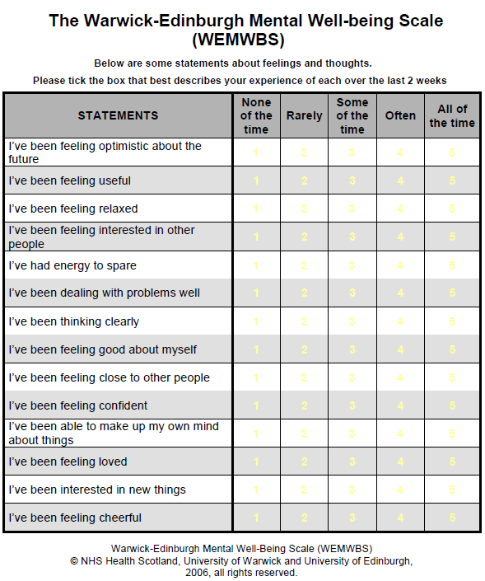

Slide 18
REFERENCE
Mental health Systems in the European Union Member States, Status of Mental Health in Populations and Benefits to be Expected from Investments into Mental Health. European profile of prevention and promotion of mental health (EuroPoPP-MH). 2013. https://ec.europa.eu/health//sites/health/files/mental_health/docs/europopp_full_en.pdf
Mental Health Foundation. 2018. Recovery. https://www.mentalhealth.org.uk/a-to-z/r/recovery
Kutcher S,Wei Y, & Hashish M. 2016.- Chapter 8 - Mental Health Literacy for Students and Teachers: A “School Friendly” Approach, Editor(s): Matthew Hodes, Susan Gau,Positive Mental Health, Fighting Stigma and Promoting Resiliency for Children and Adolescents, Academic Press,2016, P. 161-172, ISBN 9780128043943, https://doi.org/10.1016/B978-0-12-804394-3.00008-5.
Kutcher S, Wei Y, Coniglio C. Mental Health Literacy: Past, Present, and Future. The Canadian Journal of Psychiatry. 2016;61(3):154-158. doi:10.1177/0706743715616609
Le Boutillier, C., Chevalier, A., Lawrence, V. et al. Staff understanding of recovery-orientated mental health practice: a systematic review and narrative synthesis. Implementation Sci 10, 87 (2015). https://doi.org/10.1186/s13012-015-0275-4
Leamy M, Bird V, Le Boutillier C, Williams J, Slade M. Conceptual framework for personal recovery in mental health: systematic review and narrative synthesis. Br J Psychiatry. 2011 Dec;199(6):445-52. doi: 10.1192/bjp.bp.110.083733. PMID: 22130746.
Nordling E. 2018. Mitä toipumisorientaatio tarkoittaa mielenterveystyössä. Duodecim, 134:1476–83

